Slide 1
Azure SQL Database

Slide 2
Agenda
Introduction
Features
Scalable performance & pools
Availability capabilities
Built-in intelligence
Advanced Security & Compliance
Tools
Lab

Slide 3
Introduction
Azure SQL Database is a relational database-as-a service using the Microsoft SQL Server Engine.
SQL Database is a general-purpose relational that supports structures such as relational data, JSON, spatial, and XML.
It delivers dynamically scalable performance and provides options such as columnstore indexes for extreme analytic analysis and reporting, and in-memory OLTP for extreme transactional processing.
Microsoft handles all patching and updating of the SQL code base seamlessly and abstracts away all management of the underlying infrastructure.
SQL Database shares its code base with the Microsoft SQL Server database engine. With Microsoft's cloud-first strategy, the newest capabilities of SQL Server are released first to SQL Database, and then to SQL Server itself.

Slide 4
SQL Database delivers predictable performance at multiple service levels that provides dynamic scalability with no downtime, built-in intelligent optimization, global scalability and availability, and advanced security options — all with near-zero administration.
The SQL Database service is currently in 38 data centers around the world, with more data centers coming online regularly, which enables you to run your database in a data center near you.

Slide 5
Scalable performance and pools
With SQL Database, each database is isolated from each other and portable, each with its own service tier with a guaranteed performance level.
SQL Database provides different performance levels for different needs, and enables databases to be pooled to maximize the use of resources and save money.

Slide 6
Adjust performance and scale without downtime
SQL Database offers four service tiers to support lightweight to heavyweight database workloads: Basic, Standard, Premium, and Premium RS.
You can build your first app on a small, single database at a low cost per month and then change its service tier manually or programmatically at any time to meet the needs of your solution.
You can adjust performance without downtime to your app or to your customers.
Dynamic scalability enables your database to transparently respond to rapidly changing resource requirements and enables you to only pay for the resources that you need when you need them.

Slide 7
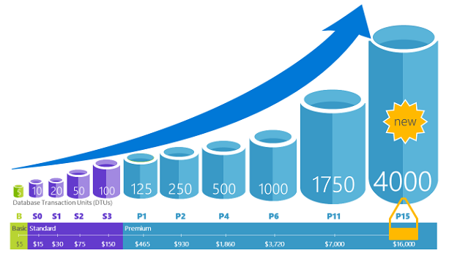

Slide 8
Elastic pools to maximize resource utilization
For many businesses and applications, being able to create single databases and dial performance up or down on demand is enough, especially if usage patterns are relatively predictable. But if you have unpredictable usage patterns, it can make it hard to manage costs and your business model.
Elastic pools are designed to solve this problem. You allocate performance resources to a pool rather than an individual database, and pay for the collective performance resources of the pool rather than for single database performance.

Slide 9
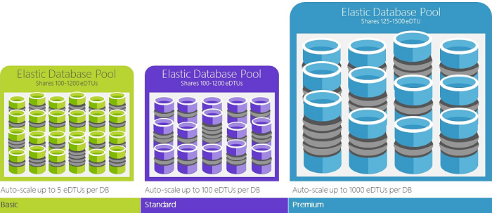

Slide 10
With elastic pools, you don’t need to focus on dialing database performance up and down as demand for resources fluctuates.
The pooled databases consume the performance resources of the elastic pool as needed.
Pooled databases consume but don’t exceed the limits of the pool, so your cost remains predictable even if individual database usage doesn’t.
You can add and remove databases to the pool, scaling your app from a handful of databases to thousands, all within a budget that you control.
You can also control the minimum and maximum resources available to databases in the pool to ensure that no database in the pool uses all the pool resources and that every pooled database has a guaranteed minimum amount of resources

Slide 11
Extensive monitoring and alerting capabilities
You use the built-in performance monitoring and alerting tools, combined with the performance ratings based on Database Transaction Units (DTUs) for single databases and elastic DTUs (eDTUs) for elastic pools.
Using these tools, you can quickly assess the impact of scaling up or down based on your current or project performance needs.
SQL Database can emit metrics and diagnostic logs for easier monitoring. You can configure SQL Database to store resource usage, workers and sessions, and connectivity into one of these Azure resources:
Azure Storage: For archiving vast amounts of telemetry for a small price
Azure Event Hub: For integrating SQL Database telemetry with your custom monitoring solution or hot pipelines
Azure Log Analytics: For built-in monitoring solution with reporting, alerting, and mitigating capabilities

Slide 12
Availability capabilities
99.99% availability service level agreement (SLA)
Built-in business continuity and global scalability features, including:
Automatic backups: automatically performs full, differential, and transaction log backups.
Point-in-time restores: recovery to any point in time within the automatic backup retention period.
Active geo-replication: configure up to four readable secondary databases in either the same or globally distributed Azure data centers.
Failover groups: enable high availability and load balancing at global scale, including transparent geo-replication and failover of large sets of databases and elastic pools.

Slide 13
Built-in intelligence:
With SQL Database, you get built-in intelligence that helps you dramatically reduce the costs of running and managing databases and maximizes both performance and security of your application.
Running millions of customer workloads around-the-clock, SQL Database collects and processes a massive amount of telemetry data, while also fully respecting customer privacy behind the scenes.
Various algorithms are continuously evaluating the telemetry data so that the service can learn and adapt with your application. Based on this analysis, the service comes up with performance improving recommendations tailored to your specific workload.

Slide 14
Automatic performance monitoring and tuning
Intelligent Insights performs automatically monitoring SQL Database performance at scale and it informs you of performance degradation issues, it identifies the root cause of the issue and provides performance improvement recommendations when possible.
Manual monitoring and tuning your database is difficult. So we have SQL Database automatic tuning.
SQL Database automatically apply recommendations, tests, and verifies each of its tuning actions to ensure the performance keeps improving. Thus, SQL Database automatically adapts to your workload in controlled and safe way.
Automatic tuning means that the performance of your database is carefully monitored and compared before and after every tuning action, and if the performance doesn’t improve, the tuning action is reverted.

Slide 15
There are two automatic tuning aspects that are available in SQL Database:
Automatic index management: Identifies indexes that should be added in your database, and indexes that should be removed.
Automatic plan correction: Identifies problematic plans and fixes SQL plan performance problems (coming soon, already available in SQL Server 2017).

Slide 16
Adaptive query processing
Adaptive query processing provides interleaved execution for multi-statement table-valued functions, batch mode memory grant feedback, and batch mode adaptive joins.
Each of these adaptive query processing features applies similar “learn and adapt” techniques, helping further address performance issues related to historically intractable query optimization problems.

Slide 17
Intelligent threat detection
Leverages SQL Database auditing to continuously monitor Azure SQL databases for potentially harmful attempts to access sensitive data.
Provides a new layer of security, which enables customers to detect and respond to potential threats as they occur by providing security alerts on anomalous activities.
Users receive alerts upon suspicious database activities, potential vulnerabilities, and SQL injection attacks, and anomalous database access patterns.
Alerts provide details of suspicious activity and recommend action on how to investigate and mitigate the threat.

Slide 18
Users can explore the suspicious events to determine if the event results from an attempt to access, breach, or exploit data in the database.
Threat detection makes it simple to address potential threats to the database without the need to be a security expert or manage advanced security monitoring systems.

Slide 19
Advanced security and compliance
SQL Database provides a range of built-in security and compliance features to help your application meet various security and compliance requirements.

Slide 20
Auditing for compliance and security
SQL Database Auditing tracks database events and writes them to an audit log in your Azure storage account.
Auditing can help you maintain regulatory compliance, understand database activity, and gain insight into discrepancies and anomalies that could indicate business concerns or suspected security violations.

Slide 21
Data encryption at rest
SQL Database transparent data encryption helps protect against the threat of malicious activity by performing real-time encryption and decryption of the database, associated backups, and transaction log files at rest without requiring changes to the application.
Transparent data encryption (TDE) is SQL’s proven encryption-at-rest technology that is required by many compliance standards to protect against theft of storage media.
Customers can manage the TDE encryption keys and other secrets in a secure and compliant manner using Azure Key Vault.

Slide 22
Data encryption in motion
SQL Database is the only database system to offer protection of sensitive data in flight, at rest and during query processing with Always Encrypted.
Always Encrypted is an industry-first that offers unparalleled data security against breaches involving the theft of critical data.
With Always Encrypted, customers’ credit card numbers are stored encrypted in the database always, even during query processing, allowing decryption at the point of use by authorized staff or applications that need to process that data.

Slide 23
Dynamic data masking
SQL Database dynamic data masking limits sensitive data exposure by masking it to non-privileged users.
Dynamic data masking helps prevent unauthorized access to sensitive data by enabling customers to designate how much of the sensitive data to reveal with minimal impact on the application layer.
It’s a policy-based security feature that hides the sensitive data in the result set of a query over designated database fields, while the data in the database is not changed.

Slide 24
Row-level security
Row-level security enables customers to control access to rows in a database table based on the characteristics of the user executing a query (such as by group membership or execution context).
Row-level security (RLS) simplifies the design and coding of security in your application.
RLS enables you to implement restrictions on data row access. For example ensuring that workers can access only those data rows that are pertinent to their department, or restricting a customer's data access to only the data relevant to their company.

Slide 25
AAD integration & multi-factor authentication
SQL Database enables you to centrally manage identities of database user and other Microsoft services with Azure Active Directory integration. This capability simplified permission management and enhances security.
Azure Active Directory supports multi-factor authentication (MFA) to increase data and application security while supporting a single sign-on process.

Slide 26
Compliance certification
SQL Database participates in regular audits and has been certified against several compliance standards.

Slide 27
Easy-to-use tools
SQL Database makes building and maintaining applications easier and more productive.
SQL Database allows you manage and develop using tools and skills you already have.
Azure portal
SQL Server Management Studio
SQL Server Data Tools in Visual Studio
Visual Studio Code
SQL Database supports building applications with Python, Java, Node.js, PHP, Ruby, and .NET on the MacOS, Linux, and Windows.
SQL Database supports the same connection libraries as SQL Server.

Slide 28
Lab: Create Azure SQL DB using Portal

Slide 29
Lab: Creating Azure SQL DB using CLI

Slide 30
Lab: Creating Azure SQL DB using PowerShell

Slide 31
Thank you
Technical Learning Services

